Slide 1


FAIR-by-Design Methodology Training Wrap-Up
Sonja Filiposka, UKIM
orcid.org/0000-0003-0034-2855

Slide 2
FAIR-by-Design Methodology Session 1 & 2
Backward Instructional Design Empowered with FAIR principles
focusing on both learners and peer instructors
Prepare
Discover
Design
Produce
Publish
Verify
Deliver
Session 1
Session 2

Slide 3
FAIR-by-Design Methodology Details
Up-to-Date Methodology
https://fair-by-design-methodology.github.io/FAIR-by-Design_Book/
ToT course on Skills4EOSC LMS
https://learning.skills4eosc.eu/course/view.php?id=19
Training GitBook
https://fair-by-design-methodology.github.io/FAIR-by-Design_ToT/latest/
GitHub
https://github.com/FAIR-by-Design-Methodology/FAIR-by-Design_ToT

Slide 4

Help us improve
We are very interested in your thoughts and ideas
Let us co-create and make a new, improved, version of the FAIR-by-Design materials together
https://ec.europa.eu/eusurvey/runner/FAIR-by-Design_Open_Survey

Slide 5

Co-creation input
EC Survey is always open
GitHub Issues
You have an idea for an additional feature or fix?
GitHub Discussions
Ask a question or comment or anything
Pull requests
Have any specific suggestions to improve
Feedback form
Tell us what you think about this training
Post-mortem document
You used the methodology? Let us know how did it go…
In feedback on the GitHub repo

Slide 6
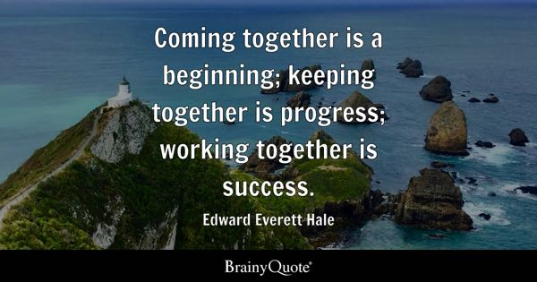
Quote
Edward Everett Hale Quotes. (n.d.). BrainyQuote.com. Retrieved September 13, 2024, from BrainyQuote.com Web site

Slide 7


Thank you! Remember: support is one step away!

